Slide 1
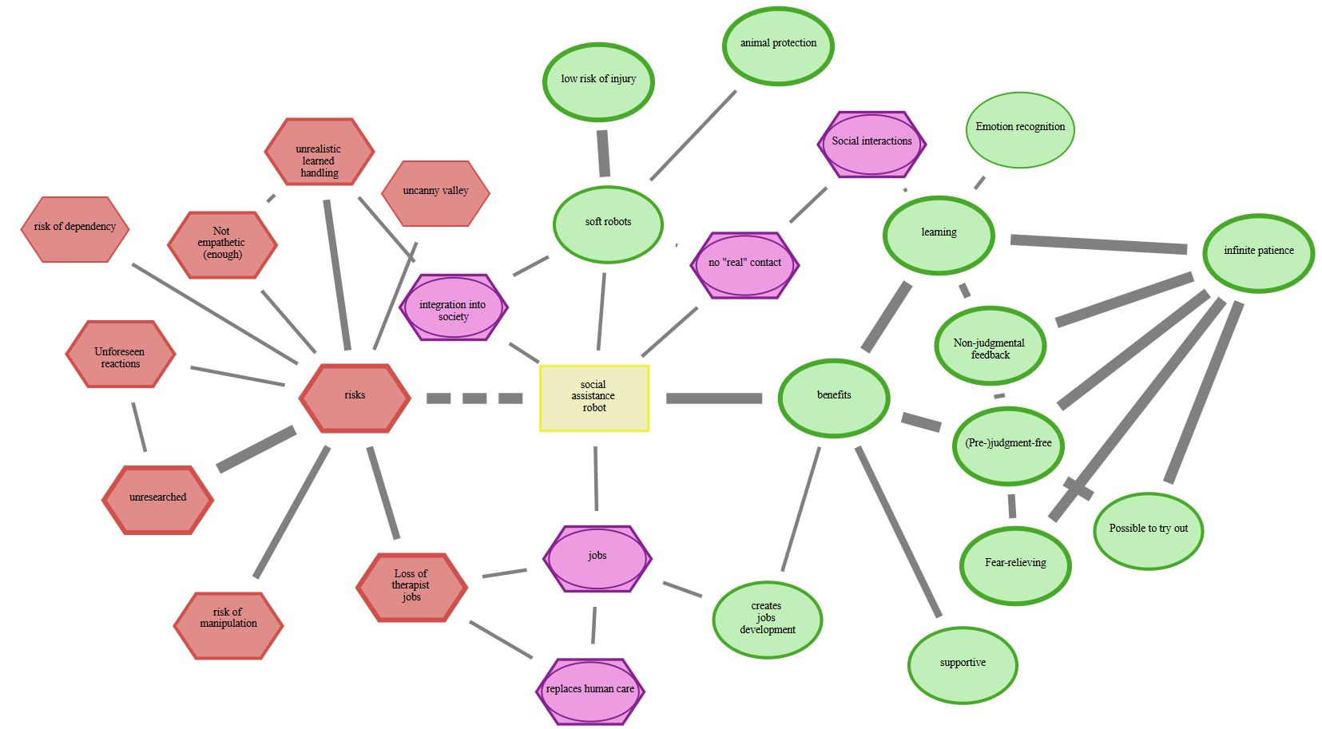
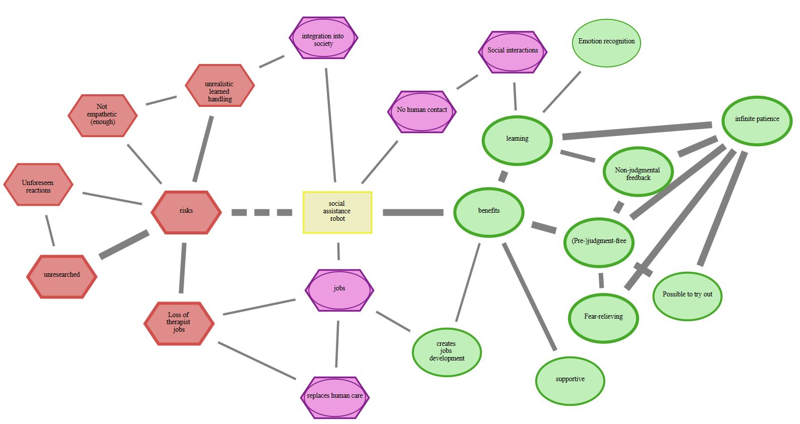
animal protection
low risk of injury
no human contact
non-judgmental feedback
xxx
Perceived risks and benefits of soft robots
Perceived risks and benefits of conventional robots
loss of therapist jobs
risk of dependency

Slide 2
Perceived risks and benefits of conventional robots
Perceived risks and benefits of soft robots
animal protection
low risk of injury
no human contact
non-judgmental feedback
xxx
loss of therapist jobs
risk of dependency

